Slide 1

CSC6013 - Algorithms and Discrete Structures
Data structures - Trees and Graphs - Week 3
Prof. Paulo Fernandes, Ph.D.

Slide 2

3/8 of the course
Week 3
This is a very fast paced course, I hope you are up to date because we comes the third topic: Data Structures: Trees and Graphs

Slide 3

Agenda
Week 3 Presentation
Data Structures: Trees
Why trees? Aren’t lists enough?
A tree in CS perspective
Tree kinds
Tree traversals
In Python
Implementing trees in Python
Data Structures: Graphs
What is a graph?
The graphs’ family tree
Graph applications
In Python
Graphs as matrices
Graph examples

Slide 4

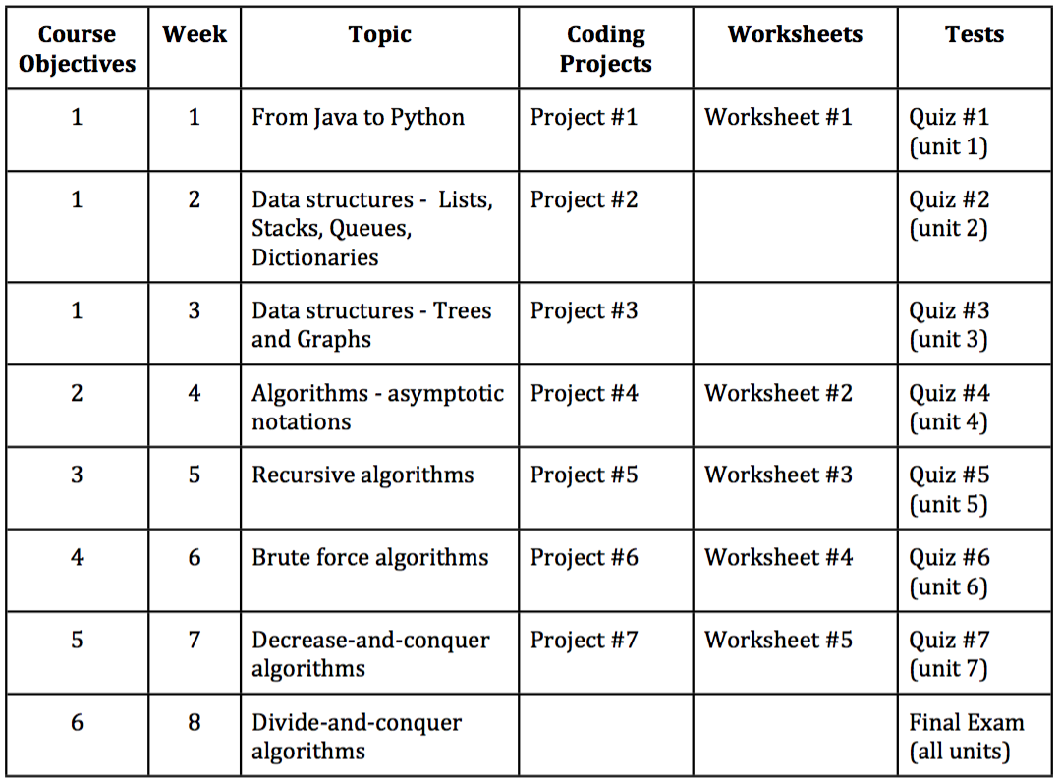
Course Introduction
8-week course
Course Timeline
Read the Syllabus!!

Slide 5

Week 3
Data Structures: Trees and Graphs
Now that you know some Data Structures…
The difference between what is simple and what is complex is not an essential characteristic of the topics. It depends on you knowing it already, and therefore it is simple, or not knowing yet, then it is obviously complex. Like the simple lists and the complex trees, as what you (hopefully) know by now.

Slide 6
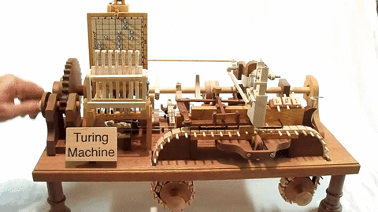
Data Structures
Why trees? Aren’t lists enough?
Data Structures: Trees
It is formally proven for almost a century that everything that can be programmed in a computer language, no matter how modern it is, can also be implemented in a rudimentary “automatic machine” as defined by Alan Turing in the 1936
Check it out about Turing Machine, but here the important thing is that this kind of machine uses only a linear tape that is the physical equivalent of a list
Hence, we may ask: a list must be enough, right?
From a power of representation point of view, yes, but remember that data structures are all about abstractions…

Slide 7

Data Structures
Why trees? Aren’t lists enough?
Data Structures: Trees
Every more complex structure can be ultimately represented by a list, and tree structures are no different
However, from an abstract point of view, thinking about a tree structure allow us to better organize our thoughts in order to establish basic operations and define behaviors that make our algorithms easier to develop, and consequently, more reliable
In simple words, a list is a sequence of elements unidimensionally (a single line) one following another, while a tree establishes a sequence where more lines may branch

Slide 8
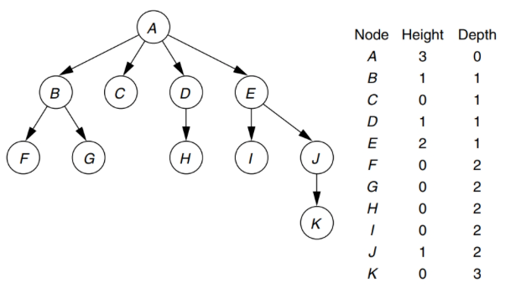
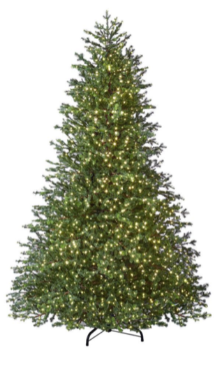

Data Structures
A tree in CS perspective
Data Structures: Trees
Nodes
Root - no parent
Internals
Leaves - no child
Edges
Connecting nodes
Height
How deep you can go towards the leaves
Depth
How far you are from the root
Path
A sequence of edges and nodes from a node to a descendant destination node

Slide 9
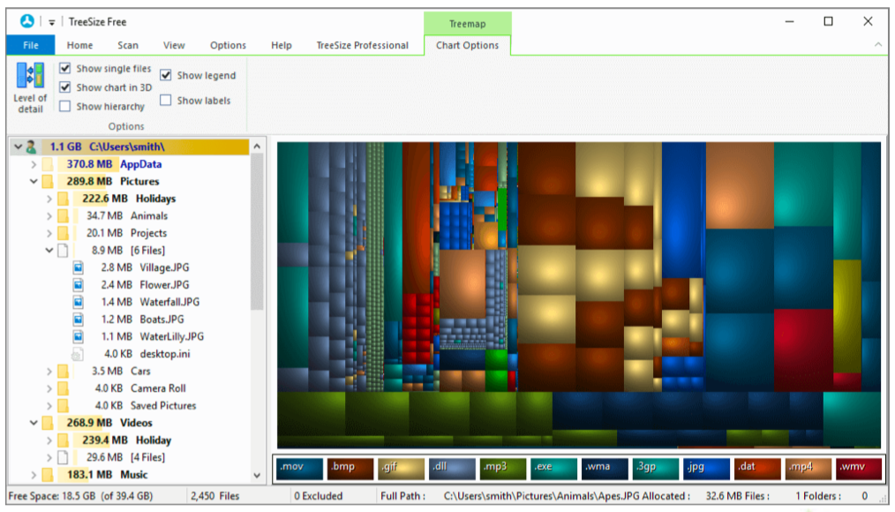
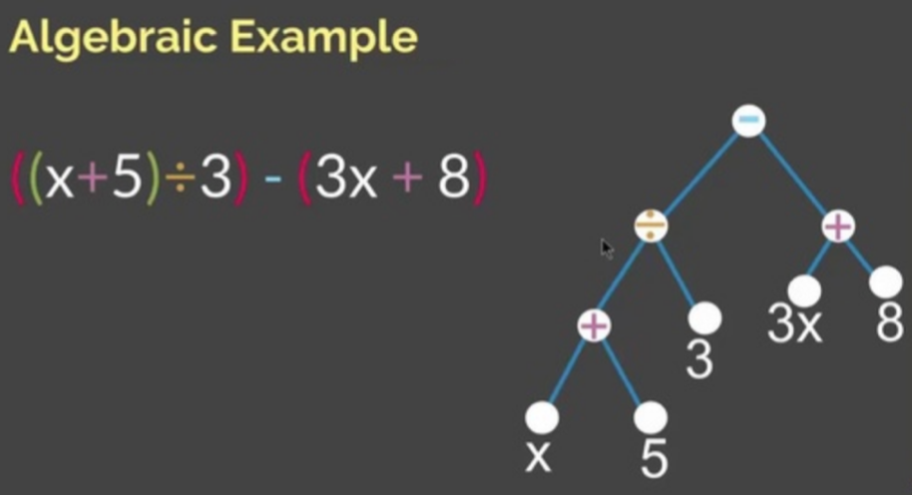
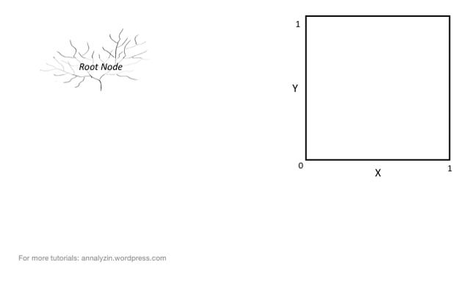
Data Structures
A tree in CS perspective
Data Structures: Trees
Standard applications
File system
Algebraic expressions
Binary search
Other applications
Algorithm paths
Game strategies
Decisions - control flow
Decisions - machine learning
Genealogy
Smart backup - Version control
Taxonomy
Classes hierarchy

Slide 10
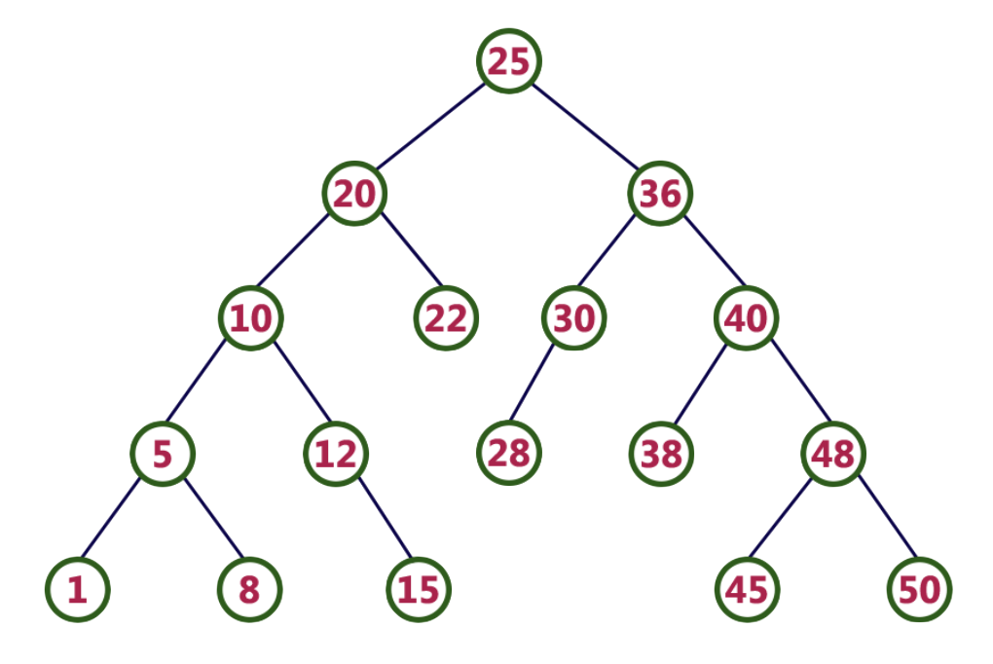
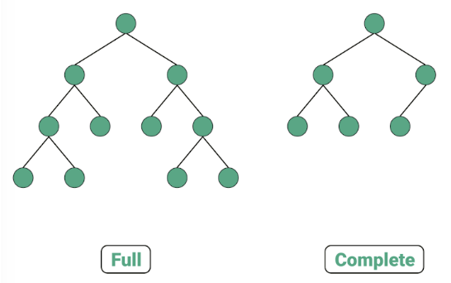
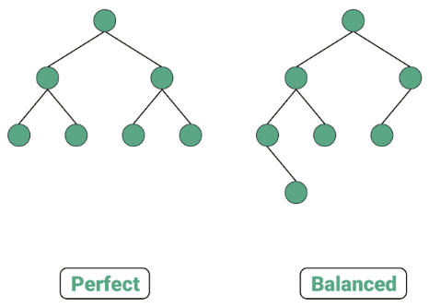
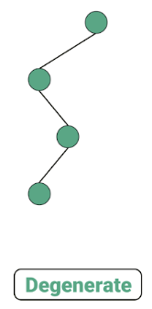
Data Structures
How many kinds of trees in CS?
Data Structures: Trees
Number of children
Limited number (Unlimited is rare)
Binary trees - two children at most
N-ary trees - N children at most
Fulfillment
Full - N or zero children per node
Complete - all levels fully filled, except the last one in which all nodes are left sided
Perfect - all internal nodes filled and all leaves are at the same depth
Balanced - height of subtrees of every node may differ by at most 1
Degenerated - all nodes with 1 or 0 children

Slide 11
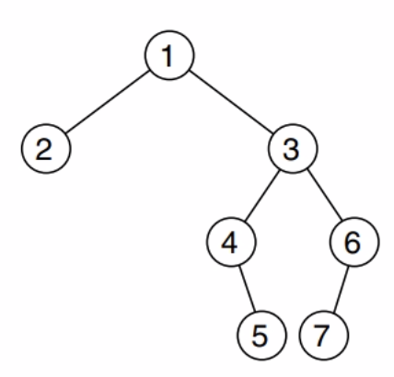
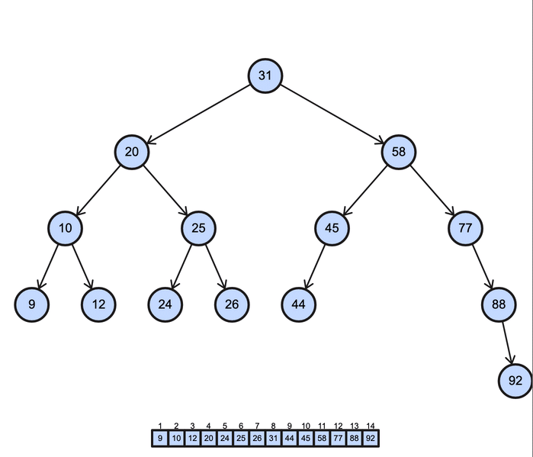
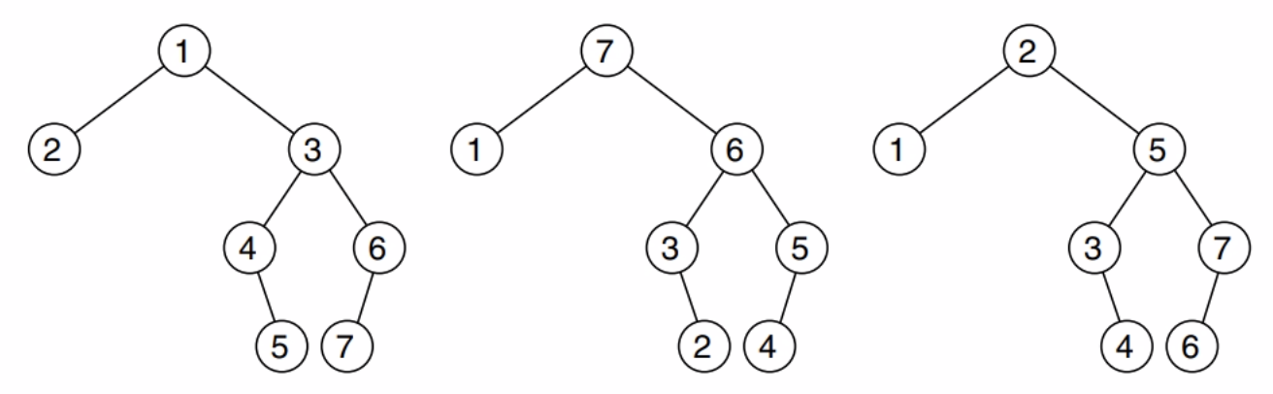
Data Structures
Tree traversals
Data Structures: Trees
Ways to visit a tree
Breadth-first - look for nodes in levels
Depth-first - look recursively
Preorder - visit node, than children
Postorder - visit children, than node
Inorder - visit first child, than node, than next child(s)
level order
preorder
postorder
inorder

Slide 12
SPOILER ALERT! Answer in the next slides! SKIP THEM!
Data Structures
Trees kinds and traversals exercise
Data Structures: Trees
According to the number of childs, what kind is this tree?
According to fulfillment, what kind is this tree?
If you visit this tree by breadth-first what is the sequence of visited nodes?
If you visit this tree using preorder what is the sequence of visited nodes?
If you visit this tree using postorder what is the sequence of visited nodes?
If you visit this tree using inorder what is the sequence of visited nodes?

Slide 13
SPOILER ALERT! Answer in this slide! SKIP IT!
Data Structures
Trees kinds and traversals exercise
Data Structures: Trees
According to the number of childs, what kind is this tree?
It looks like it is a binary tree, but you cannot be sure, unless you assume it is already filled
According to fulfillment, what kind is this tree?
Assuming a binary tree, this is
not Full (nodes 12 & 30 with 1 child)
not Complete (4th level is incomplete)
not Perfect (not full and nodes 22, 28, & 38 are not at depth 4 s the other leaves)
not Balanced (subtrees of node 20 have height 1 & 3)
not Degenerated (nodes with 2 children)

Slide 14
SPOILER ALERT! Answer in this slide! SKIP IT!
Data Structures
Trees kinds and traversals exercise
Data Structures: Trees
If you visit this tree by breadth-first
25, 20, 36, 10, 22, 30, 40, 5, 12, 28, 38, 48, 1, 8, 15, 45, 50
If you visit this tree using preorder
25, 20, 10, 5, 1, 8, 12, 15, 22, 36, 30, 28, 40, 38, 48, 45, 50
If you visit this tree using postorder
1, 8, 5, 15, 12, 10, 22, 20, 28, 30, 38, 45, 50, 48, 40, 36, 25
If you visit this tree using inorder
1, 5, 8, 10, 12, 15, 20, 22, 25, 28, 30, 36, 38, 40, 45, 48, 50

Slide 15

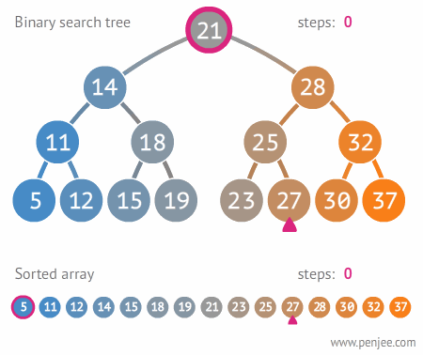
Data Structures
Implementing Trees in Python
Data Structures: Trees
For example, for binary trees, we extend the linked list implementation
Two classes:
The node
The data, a pointer to the left child, and another pointer to the right child
The tree
A pointer to the root
Basic operations to insert, check, and print
Trees must follow a predefined criteria, for example, aiming binary search
We assume ordered values for insert and print using preorder, inorder, or postorder

Slide 16
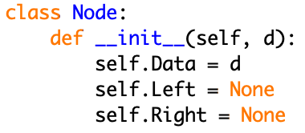
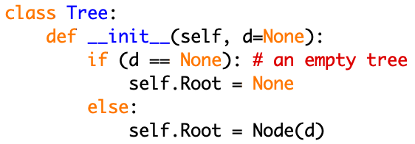
Data Structures
Implementing Trees in Python
Data Structures: Trees
Two classes:
The node
The data, a pointer to the left child, and another pointer to the right child
The tree
A pointer to the root

Slide 17
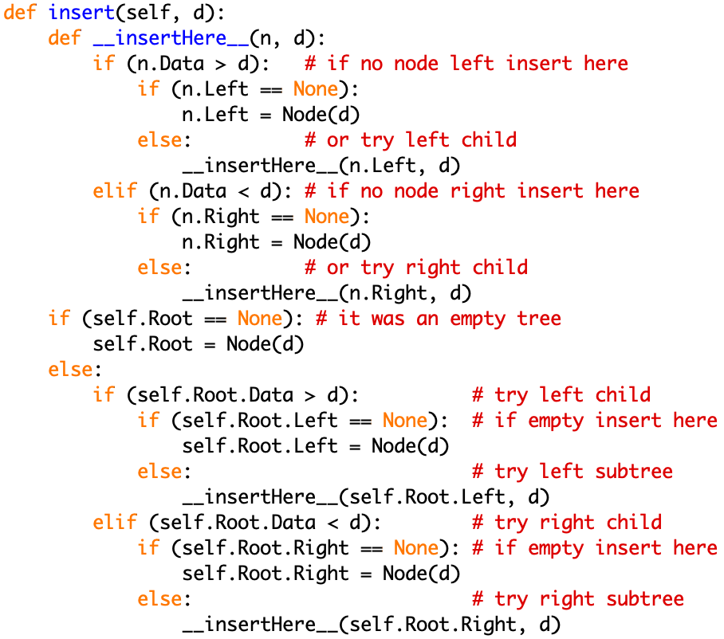
Data Structures
Implementing Trees in Python
Data Structures: Trees
Basic operations to insert, check, and print
Trees must follow a predefined criteria, for example, aiming binary search

Slide 18
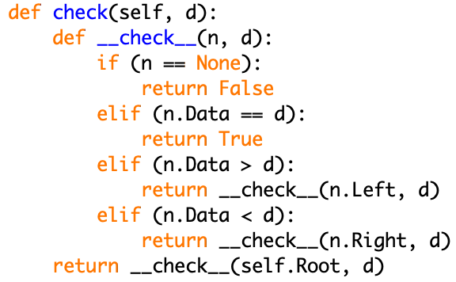
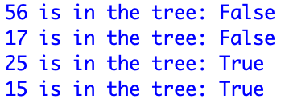
Data Structures
Implementing Trees in Python
Data Structures: Trees
Basic operations to insert, check, and print
Trees must follow a predefined criteria, for example, aiming binary search

Slide 19
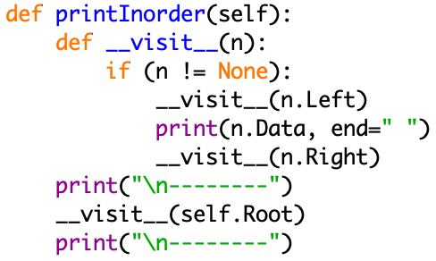
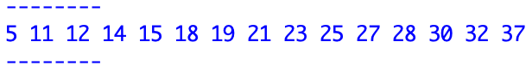
Data Structures
Implementing Trees in Python
Data Structures: Trees
Basic operations to insert, check, and print
Inorder
Left
Node
Right

Slide 20
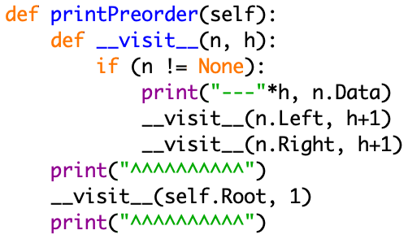
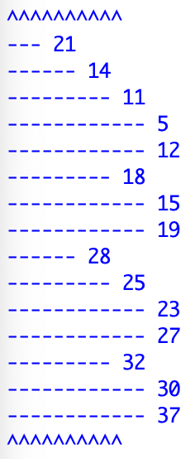
Data Structures
Implementing Trees in Python
Data Structures: Trees
Basic operations to insert, check, and print
Preorder
Node
Left
Right

Slide 21
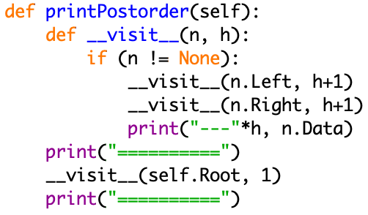
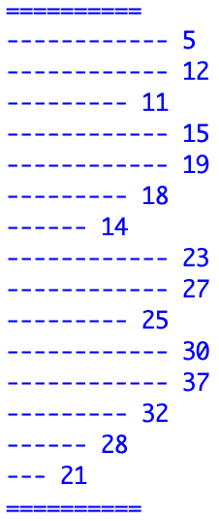
Data Structures
Implementing Trees in Python
Data Structures: Trees
Basic operations to insert, check, and print
Postorder
Left
Right
Node

Slide 22
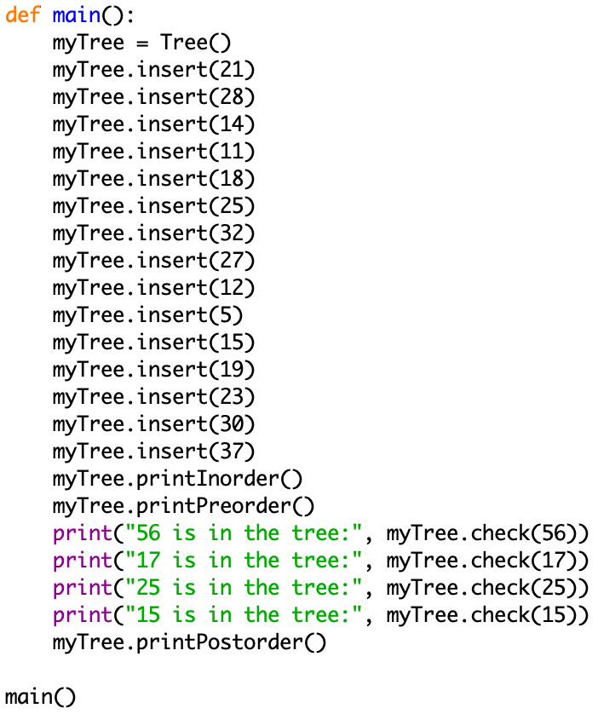
Data Structures
Implementing Trees in Python
Data Structures: Trees
Download full code

Slide 23
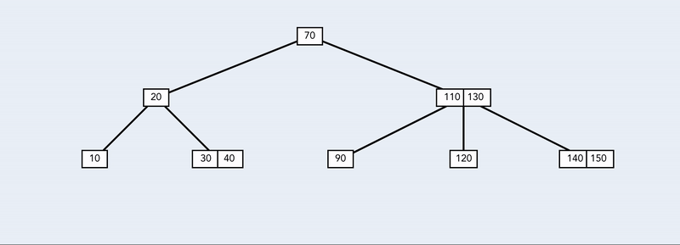
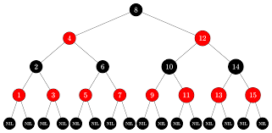
Data Structures
Implementing Trees in Python
Data Structures: Trees
Other implementations are possible
N-ary trees, not only binary
Other criteria, not only binary search
Heaps (a.k.a. priority queues)
Self-balanced queues
B-trees
Black and red trees
…
Other operations
Removal
Height
Pruning
…

Slide 24
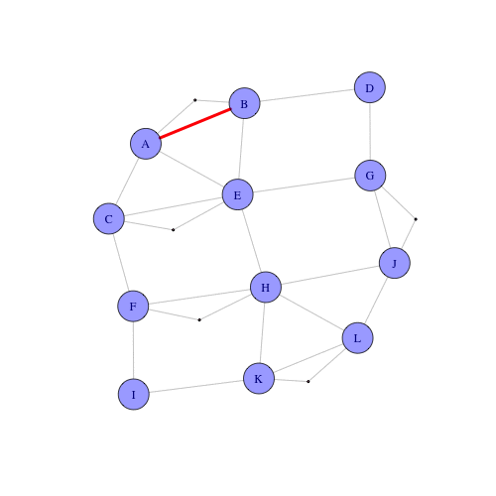
Data Structures
What is a graph?
Data Structures: Graphs
A tree has a root and it goes in a single direction, from the root to the leaves
What if the nodes go go anywhere?
This will be a graph!
Vertices
Usually identified, capable of holding information (or not)
Edges
Connecting two vertices, usually holding information (weight)
An abstraction of all sorts of connections
Geographic distributions
Edges can be roads, flights
Personal connections
six degrees - IMDb / K. Bacon

Slide 25
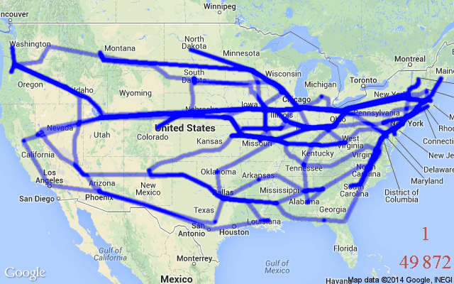
Data Structures
What is a graph?
Data Structures: Graphs
An abstraction of all sorts of connections
A map can be described as a graph
Each city is represented by a vertex
Each road between two cities is an edge
The distance of the road the weight of the edge
Such graph can be used to compute paths
Human relations can be described as a graph
Each actor in IMDb can be a vertex
If two actors acted together in a movie or pub there is edge between them
Such graph can be use to find the maximum degree of connection for all pairs of actors (the answer was 6 in 2011)

Slide 26
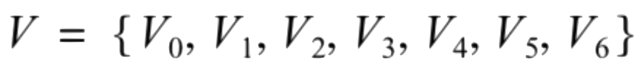
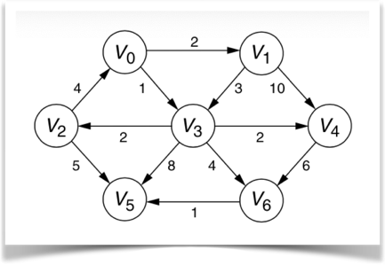
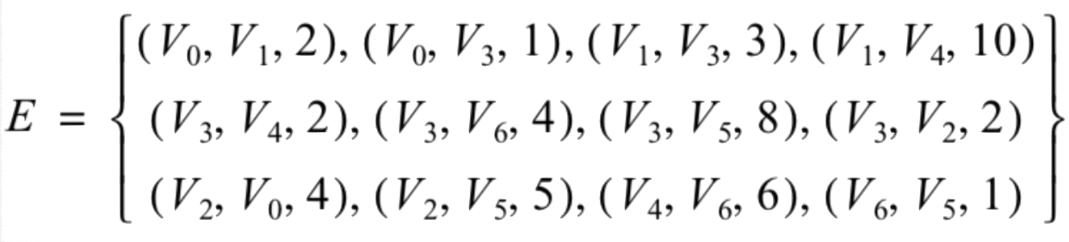
Data Structures
Formal definition of graphs
Data Structures: Graphs
A set of Vertices
Each vertice is linked to other vertices by an edge
Each pair of vertices has a value that indicates its edge weight

Slide 27
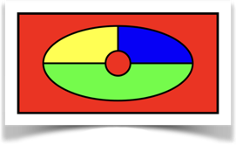
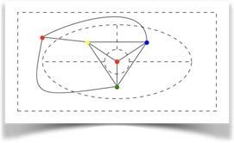
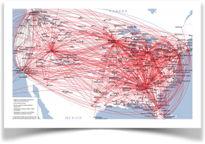
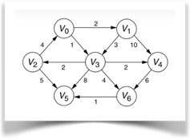
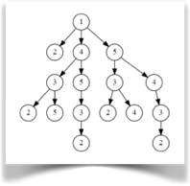
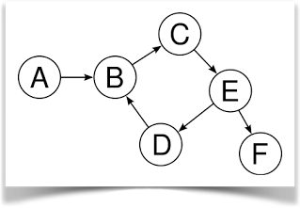
Data Structures
The graphs’ family tree
Data Structures: Graphs
According to direction
Graphs can be directed or not (edges can be ordered or not)
According to weight of edges
0 and 1 (unweight)
A zero or positive number (weighted graph)
A zero, positive or negative number
According to existence of cycles or not
Acyclic graphs
Cyclic graphs
DAGs - WCGs

Slide 28

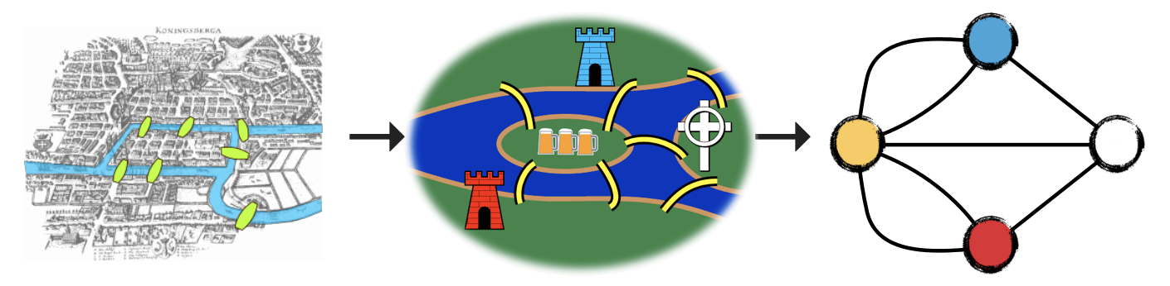
Data Structures
Graph applications
Data Structures: Graphs
The Bridges of Königsberg
How to take a walk around Königsberg and pass through all the bridges not crossing the rivers by any other means than by the bridges, and never crossing a bridge more than once

Slide 29

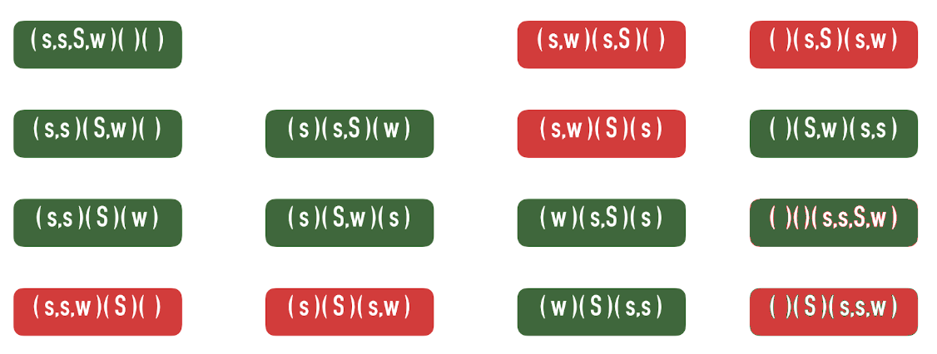
Data Structures
Graph applications
State space graph
Data Structures: Graphs
Sheeps and Wolves
You are a Shepherd at one bank with two sheeps and one wolf
How to cross all animals through the river taking one animal at a time, but never letting a sheep and a wolf unattended

Slide 30
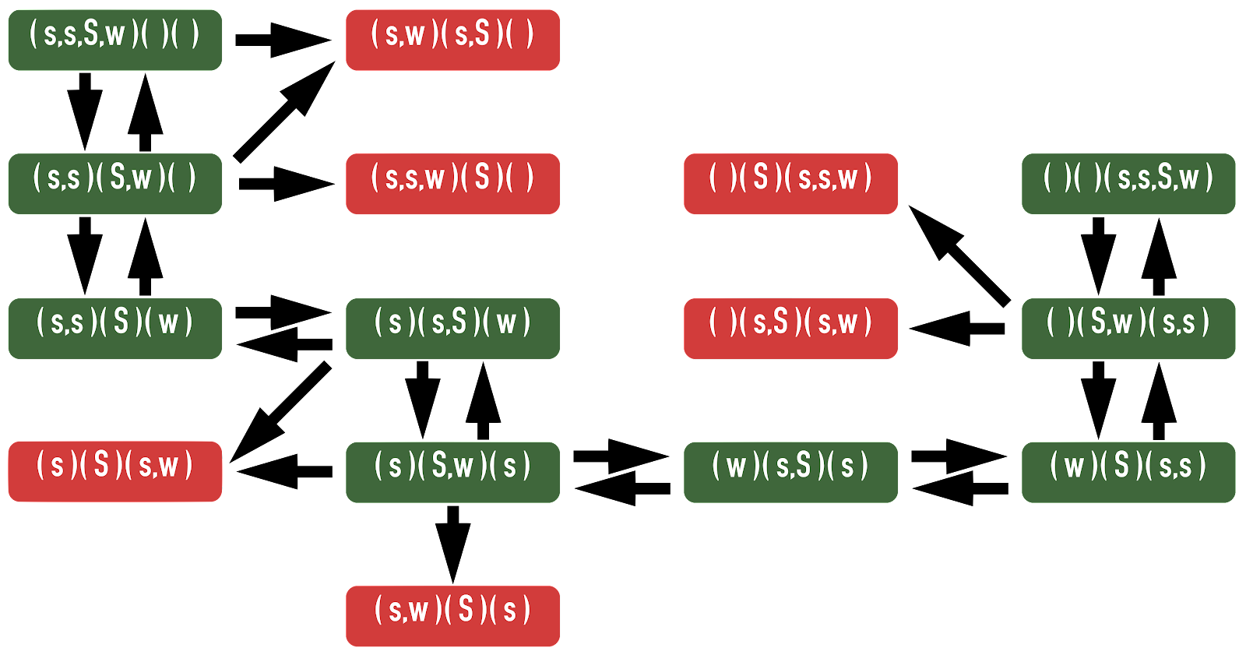
Data Structures
Graph applications
Data Structures: Graphs
The answer is to find the graph path, from the starting position to the goal one
Sheeps and Wolves

Slide 31
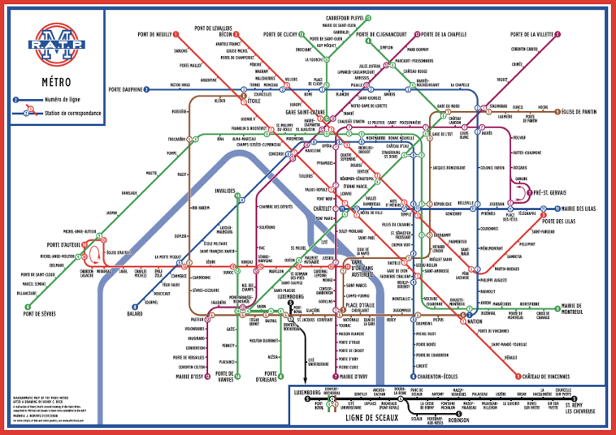
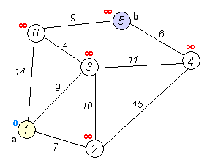
Data Structures
Graph applications
Data Structures: Graphs
We use that in pretty much all GPSs
Shortest path

Slide 32
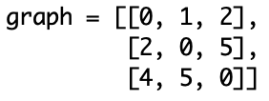
Data Structures
Implementing Graphs in Python
Data Structures: Graphs
Usually, graphs are represented using adjacency matrix
A square matrix NxN for N vertices
Each element i, j (row, column) represents an edge from vertex i to vertex j
1
2
5
Simple
Efficient
Direct access by indexing
May waste space for very sparse graphs
1
5
2
0
2
4

Slide 33
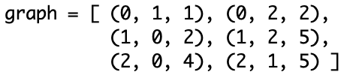
Data Structures
Implementing Graphs in Python
Data Structures: Graphs
For sparse graphs it is interesting to represent using adjacency list
A list of triplets (origin, target, weight)
1
2
5
1
5
Simple
Structured
Sequential access by visiting all list elements
Save space for very sparse graphs
2
0
2
4

Slide 34

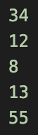
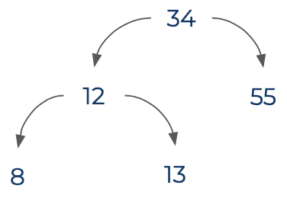
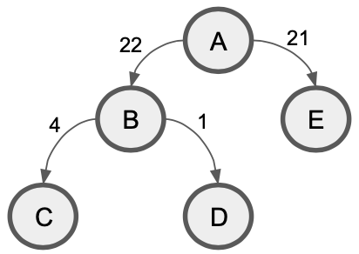

Data Structures
Project #3 - this week's Assignment
Third Assignment
Create a program that reads a list of numbers from a text file named “numbers.txt” and create a binary tree ordered as the example presented in class
From the tree structure you have created, create and print a adjacency matrix that represents the graph equivalent to the tree, considering an edge from the node to its child with weight the absolute value of the difference between the numbers of the nodes
For example:

Slide 35
Data Structures
Project #3 - this week's Assignment
Third Assignment
This program must be your own, do not use someone else’s code
Any specific questions about it, please bring to the Office hours meeting this Wednesday or contact me by email
This is a challenging program to make sure you are mastering Trees and Graphs in Python
Don’t be shy with your questions
Go to IDLE and try to program it
Save your program in a .py file and submit it in the appropriate delivery room
Deadline: Monday May 30 2022 11:59 PM EST

Slide 36
That’s all for today folks!
This week’s tasks
Next week
No tasks for the Worksheets this week
However, a lot of exercises to practice
Quiz #3 to be available this Friday
Deadline: Monday May 30 11:59pm
Project #3 assignment
Deadline: Monday May 30 11:59pm
Try all exercises seen in class and consult the reference sources, as the more you practice, the easier it gets
Algorithms
Asymptotic notations
Don’t let work pile up!
Don’t be shy about your questions
Have a Great Week!

